Slide 1
Presentation
Final Year Project

Slide 2

Express Service Station

Slide 3
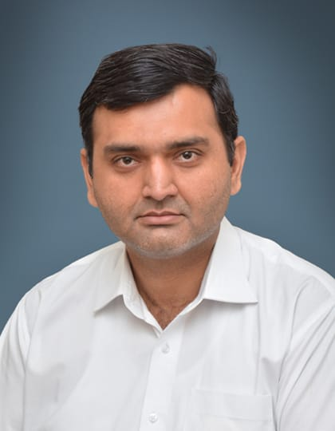
Project Supervisor
Prof. Saad Razzaq

Slide 4
TEAM

Slide 5
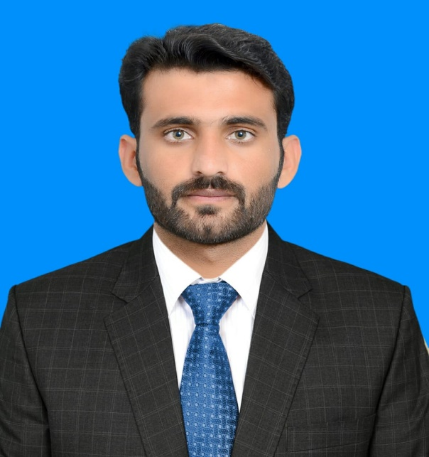


Team Member
Professional team that can solve just anything you need
Sajid Ali
Khan
Shakeel Abbas Khan
Mohsin Farooq Khan
BCSF18E025
BCSF18E030.
BCSF18E039

Slide 6
Abstract
Mostly when people go to service stations to wash their vehicles, they have to wait a long time for their turn. We will resolve this issue by developing a Web based application, to save people's precious time, where users can book their time slots for washing their vehicles, and they arrive at their appointed time to get services regarding vehicles without wasting their time. Also our website provides different services like oil change, air filter replacement, fuel filter replacement, cabin filter replacement, wiper blades, headlights replacement etc.

Slide 7
Project Overview
Main Objectives
This project is based on the web application development and provided the many of the functionalities to the users. They can save their precious time by getting services on exact time. They can book their time slots according to their availability. Users can easily Register and book their appointments according to their availability in less time.
Objectives:
1. Save time
2. Quick service
3. Easy to access
4. Better performance
Main Objectives are the system is a reliable secure and efficient, the system is available24/7, easy to use and friendly interface and this works with internet connectivity.
1. System will be able to provide online booking for washing vehicles.
2. System will be able to provide suitable station where you can go easily.
3. User will be able to cancel the booking in any emergency case.
4. System will provide the rating and ranking of stations.

Slide 8
Project Purpose
Express Service Station allow users to book their time slots for washing their vehicles, and they arrive at their appointed time to get services regarding vehicles without wasting their time. Also portal provides different services like oil change, air filter replacement, fuel filter replacement, cabin filter replacement, wiper blades, headlights replacement etc.

Slide 9
Project Scope
The scope of the Express Service Station is to develop a Web based application that performs smart and efficient functions to provide services to the user. Our website visited by those people who have vehicles and want to wash their vehicles. Those people who have no availability of android phone or internet connection can't get our services. Also user will be able to book his slot though messages or call.

Slide 10


OUR SERVICES
Lube Services
Oil Change

Slide 11



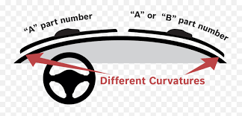
OUR SERVICES
Filter Replacement
Wash Club
Headlight Replacement
Wiper Blades

Slide 12



Packages
Platinum
Gold
Silver

Slide 13
Functional Requirements

Slide 14
Functional Requirements
01
Overview:
02
User Registration
User can get basic over view of our services without signup or logging in.
User can register on website to place order and for getting information related to Express Service Station
03
Admin Login
04
Suitable Service Station:
User can login to the portal and manage his/her dashboard
User will be able to select service station that is suitable according to his/her location.

Slide 15
Continued…
05
Book his/her Time Slot:
06
Cancel his/her booking:
User can book available time slot through portal.
User can cancel his/her booking after booking her slot and get his payment back after 20 percent deduction.
07
Payment:
08
Discount Token:
User can pay through his/her bank account, easy paisa and jazz cash.
Regular customer can get bonus discount using special tokens and our marketing offers.

Slide 16
Continued…
09
Portfolio:
10
Packages:
User can get information about our previous work and Projects.
User can get different packages where we offer different services package in different prices.
11
Services:
12
Location:
Provides different services like oil change, air filter replacement, fuel filter replacement, cabin filter replacement, wiper blades, headlights replacement etc.
User can get location of Express Services Station.

Slide 17
Continued…
13
Contact US:
14
Subscription:
User can contact us through Contact us form and through calls and SMS
User can subscribe Express Service Station and can get latest information via emails.
15
SMS or Call:
User can also contact by SMS or call.

Slide 18
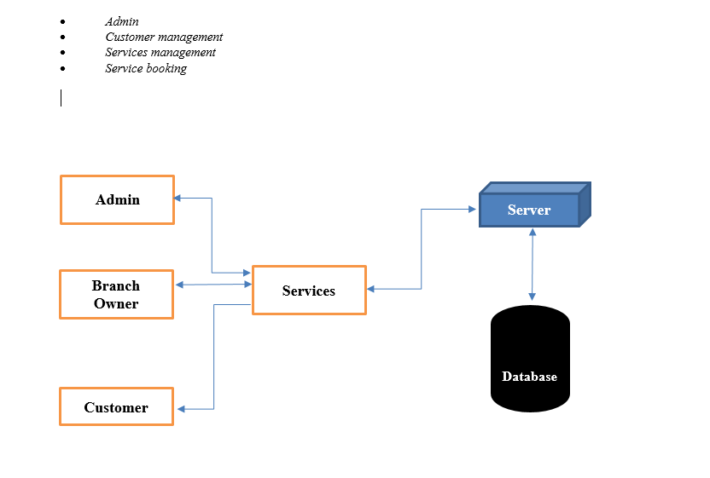
System Level-Architecture

Slide 19
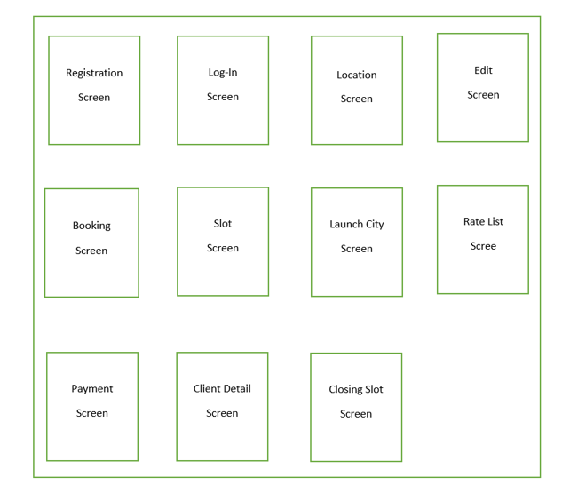
Revised System Level-Architecture

Slide 20
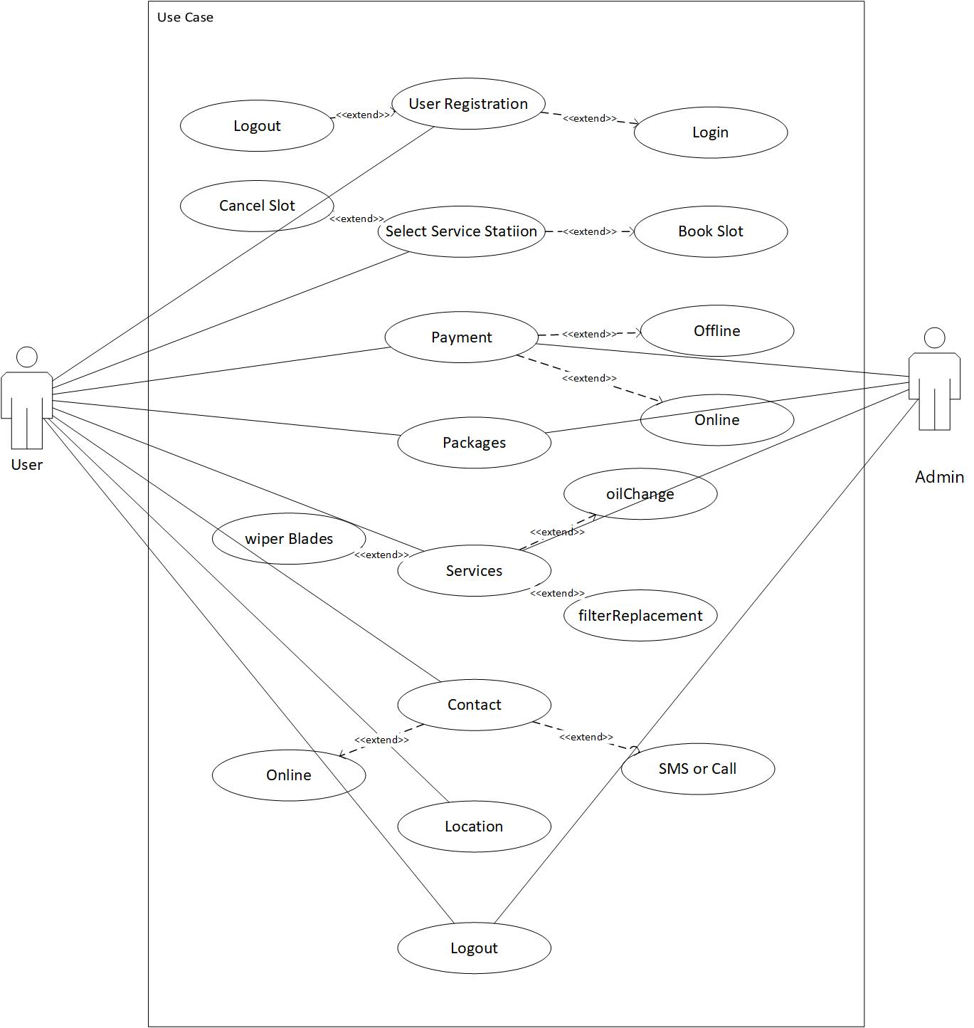
Use Case Diagram

Slide 21
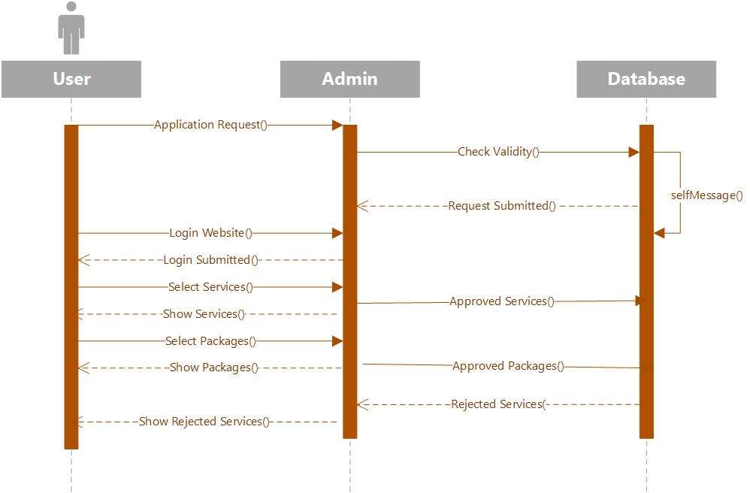
Sequence Diagram

Slide 22
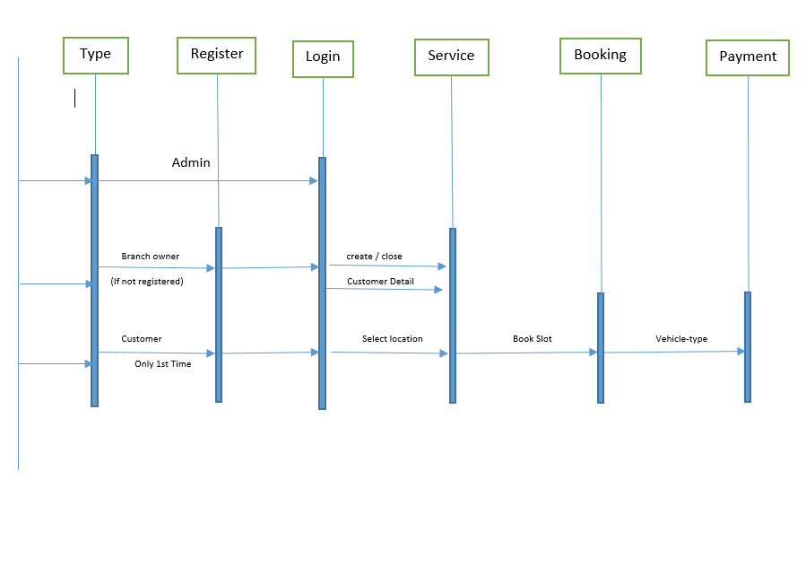
Sequence Diagram For Admin

Slide 23
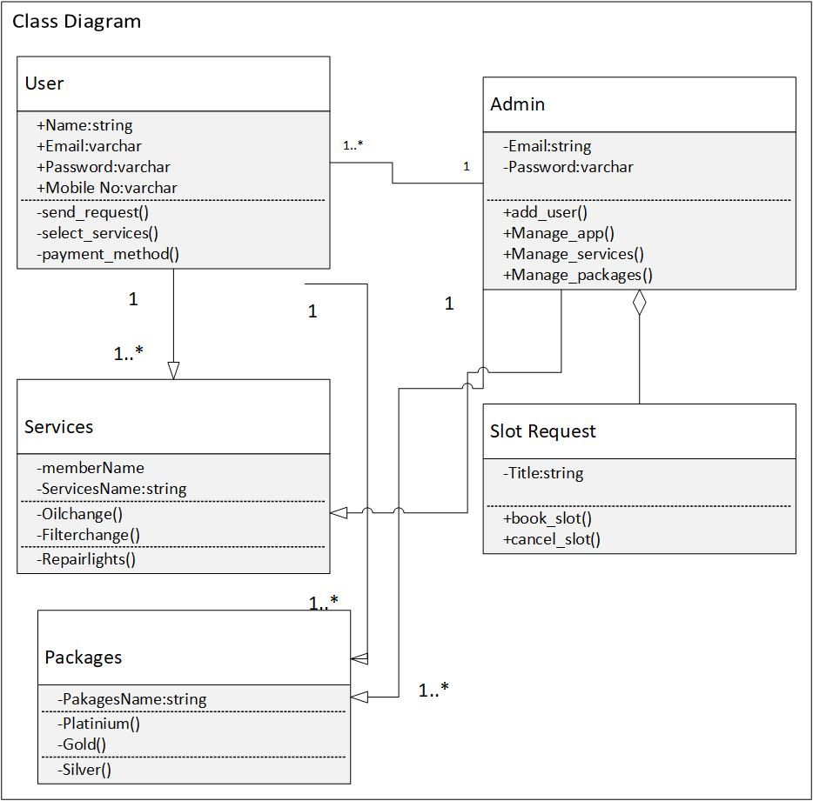
Class Diagram

Slide 24
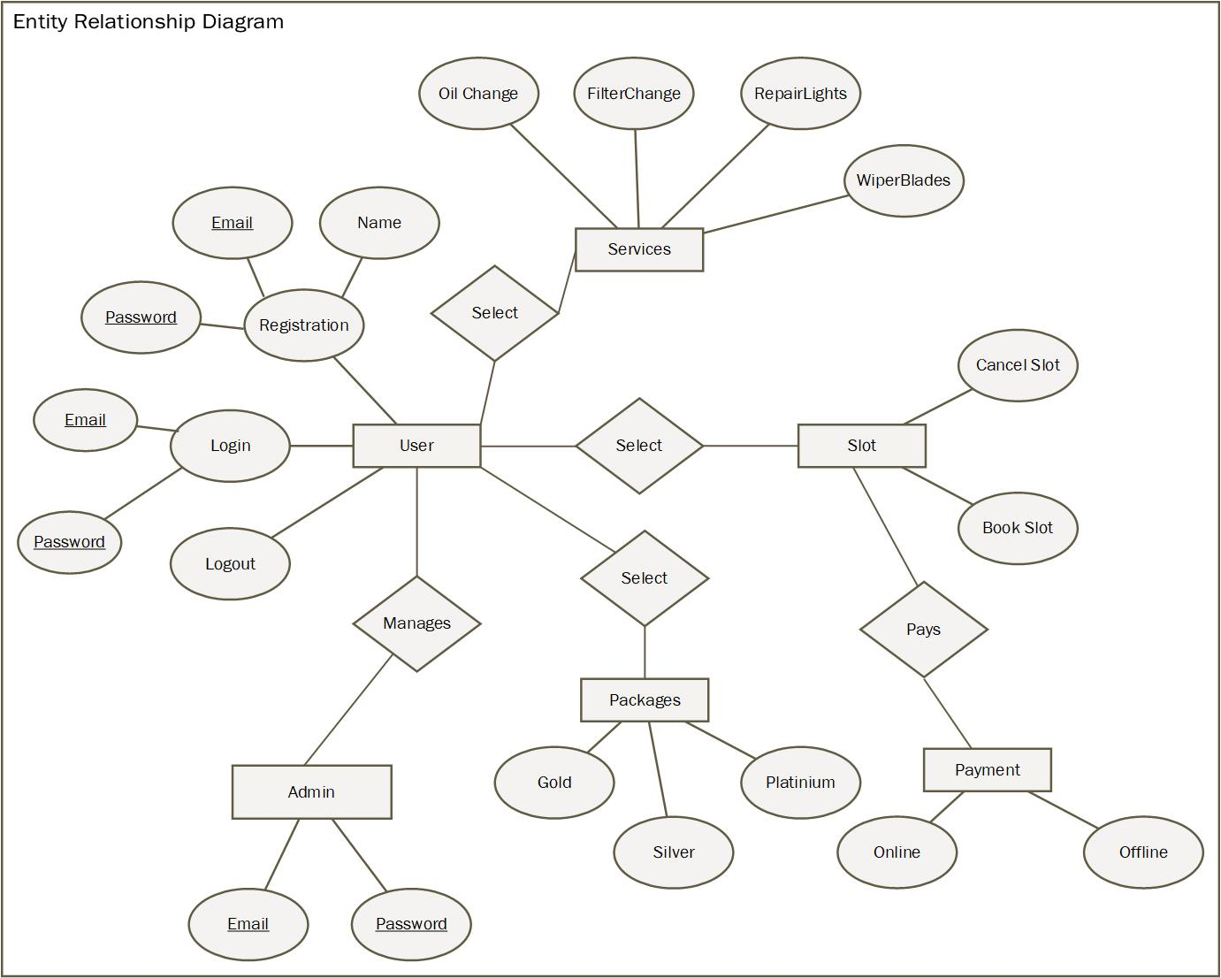
ER Diagram

Slide 25
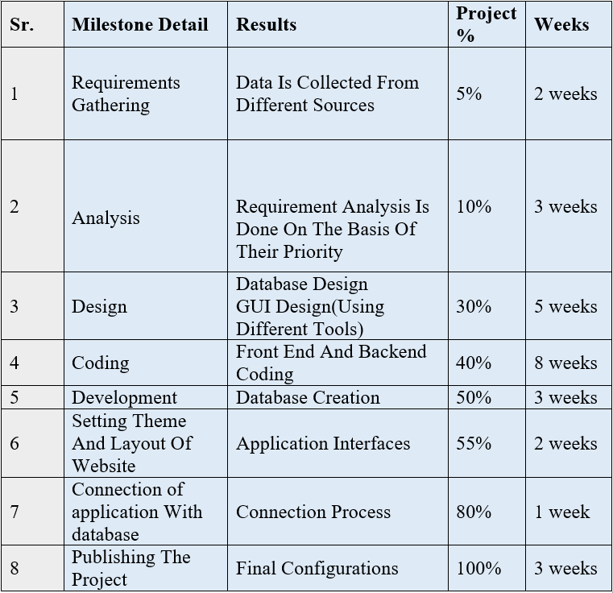
Implementation Phase

Slide 26
  Assumptions and Dependencies
Our system made multiple assumption and dependencies with users. Some of the assumptions are as follow:
First of all, customer/branch owner must have an internet connection.
Secondly, customer/ branch owner must have an android mobile or a system where he has an access of our application.
Another assumption is, customer/ branch owner must have a version of 4 GB android or above.
It is also assumed that our app is compatible with user’s hardware.
Users must have enough space to run website in their system.

Slide 27
  Risks and Volatile Areas
The design structure of our system is very flexible. We can easily add a new module in the existing system. The risks which can occur in the system are following
Fake account can cause of misguidance.
Any software or hardware failure may occur.
Any intruders in terms of hacker can affects our system.
Database may crash.
Server can be down.

Slide 28
THANK YOU!

